Slide 1




AtliQ HOSPITALITY DASHBOARD
ANALYSIS
REPORT

Slide 2
Problem Statement
AtliQ Grands owns multiple five-star hotels across India. They have been in the hospitality industry for the past 20 years. Due to strategic moves from other competitors and ineffective decision-making in management, AtliQ Grands are losing its market share and revenue in the luxury/business hotels category. As a strategic move, the managing director of AtliQ Grands wanted to incorporate “Business and Data Intelligence” to regain their market share and revenue. However, they do not have an in-house data analytics team to provide them with these insights. Their revenue management team had decided to hire a 3rd party service provider to provide them with insights from their historical data.

Slide 3
Objectives
1
2
High Level Summary
Monitor KPIs
Provide a high-level executive summary of the financial and operational performance of AtliQ Hotels.
Monitor key performance indicators (KPIs) such as Total Revenue, Occupancy Rate, ADR, and RevPAR to assess the health of the business.
3
4
Performance Analysis
Decision Making
Identify performance trends over time, by market, and by guest segment to understand business dynamics.
Support data-driven decision-making by providing actionable insights for management in areas like pricing, marketing, and operational efficiency.

Slide 4
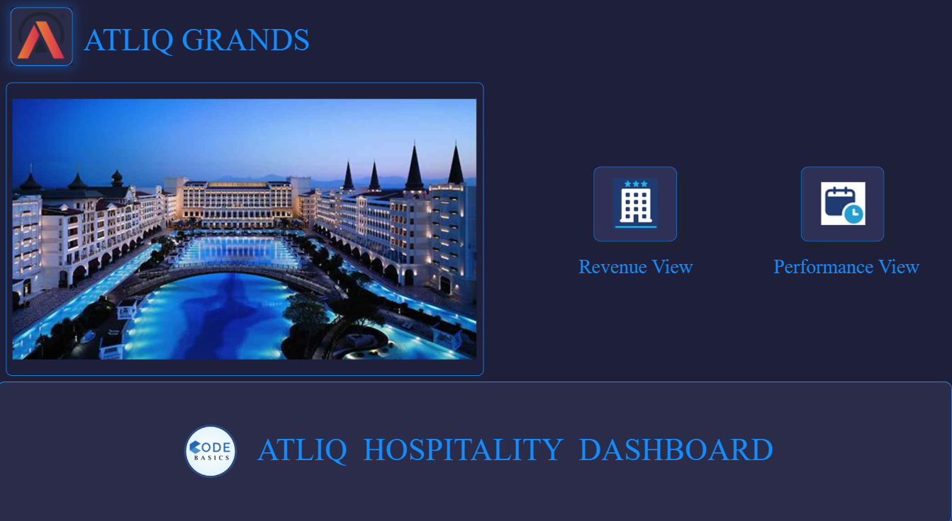

Slide 5
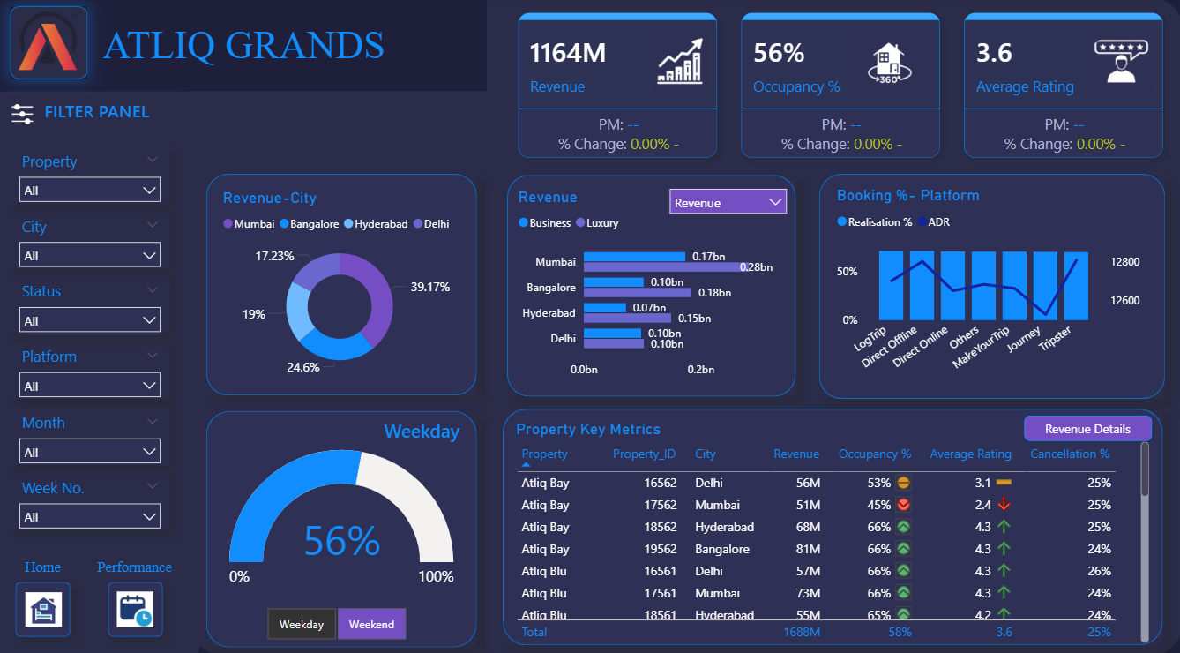

Slide 6
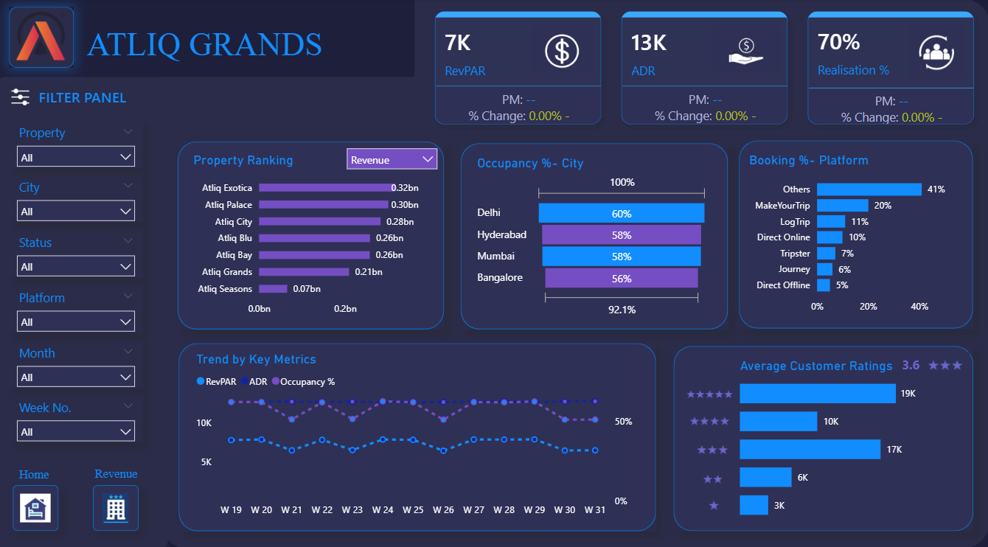

Slide 7
Insights
Financial and Operational KPIs
Total Revenue: The dashboard clearly shows a Total Revenue of ₹6.62 Billion, a critical metric for assessing the overall financial health of the business.
Occupancy Rate: At 68.6%, the occupancy rate indicates how effectively the hotels are filling their rooms. This is a key operational metric that directly impacts revenue.
Average Daily Rate (ADR): An ADR of ₹5,750 represents the average price per occupied room. This metric is a strong indicator of pricing strategy and market positioning.
Revenue Per Available Room (RevPAR): The RevPAR of ₹3,948 is a comprehensive performance metric that combines both occupancy and room rate, providing a more holistic view of revenue-generating efficiency.
Realization: At 63.8%, the realization rate provides insight into the percentage of revenue actually collected compared to potential revenue.

Slide 8
Analysis
Market-Level Performance
The dashboard allows for a detailed comparison of market performance. For example, by filtering the dashboard, you can see that Mumbai has the highest ADR and RevPAR, making it the most profitable market. This insight can guide decisions on resource allocation and expansion.
In contrast, other cities like Delhi may show lower metrics, signaling a need for focused marketing or pricing adjustments.
Booking Platform Analysis
The dashboard prominently features a breakdown of booking platforms. The data indicates that MakeMyTrip is the most significant source of bookings, highlighting the success of this partnership.
The second-largest segment is Direct bookings, followed by other Online Travel Agencies (OTAs). This provides crucial information for optimizing distribution channels and marketing efforts.

Slide 9
Analysis
Guest Segmentation
The dashboard visually segments guests into Business, Leisure, and Transit categories. The data shows that the Business segment is the largest, suggesting that the hotels are a preferred choice for corporate travelers.
This insight can inform targeted loyalty programs and marketing campaigns tailored to the needs of business guests.
Hotel-Specific Breakdown
The dashboard features a detailed table providing ADR, RevPAR, and occupancy for each individual hotel. This granular view enables a competitive analysis of properties within the chain. For example, you can easily identify top-performing hotels like AtliQ Exotica and analyze the factors contributing to their success.

Slide 10
Analysis
Temporal and Day-of-the-Week Trends
The time-series visualizations show that revenue and occupancy have distinct monthly trends, allowing stakeholders to prepare for seasonal fluctuations.
A critical insight is that bookings are significantly higher from Friday to Sunday, confirming that weekends are the peak period for business. This information is vital for optimizing staffing, pricing, and resource management.
Room Class Performance
The dashboard breaks down occupancy by room class (Standard, Elite, Premium, Presidential). This detailed view allows management to understand which room types are in highest demand and adjust inventory or pricing strategies accordingly.

Slide 11

Recommendations
Weekend Peak Management
The strong performance on weekends presents both an opportunity and a challenge. AtliQ Hotels could consider dynamic pricing strategies to maximize revenue during these peak periods. Conversely, they should explore marketing campaigns or special offers to increase occupancy on weekdays, which appear to have lower demand.
Market-Specific Strategy
The dashboard shows a significant disparity in ADR and RevPAR between markets like Mumbai and others. The company should analyze the factors contributing to Mumbai's success (e.g., pricing, amenities, target audience) and see if these strategies can be replicated in other, lower-performing markets to boost revenue.

Slide 12
Recommendations
Targeted Guest Marketing
The dominance of the "Business" guest segment suggests a strong B2B focus. AtliQ Hotels could further analyze this segment to identify key corporate clients or industries and create tailored packages. They could also launch specific campaigns to attract more Leisure and Transit guests to diversify their customer base.
Booking Channel Optimization
While MakeMyTrip is the top booking channel, the company should investigate the cost per acquisition for each platform. If the commission rates for MakeMyTrip are high, they could explore ways to increase direct bookings through their own website or app by offering exclusive deals or loyalty points.

Slide 13
Conclusion
The AtliQ Hotels dashboard is an invaluable tool for strategic decision-making. It clearly identifies profitable markets like Mumbai and highlights the success of partnerships with platforms like MakeMyTrip. The insights gained from this analysis, particularly concerning weekend peaks and guest segmentation, provide a solid foundation for management to implement targeted improvements in pricing, marketing, and overall operational efficiency to drive future growth.

